Slide 1
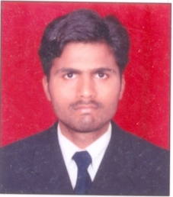
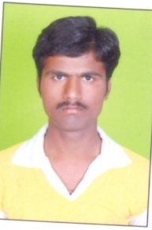
Ram Dhondiba Sagar
Name
LOCAL ADDRESS
R. D. SAGAR
C/o PROF S.V. DHARMAPURIKAR, NARHARI ENCLAVE 344,345
E – SECTORE CIDCO N-1, AUB
PERMANENT ADDRESS
AT POST GOLEGAON, TQ. AUNDHA (NA) DIST HINGOLI
Ram

Slide 2
9890717326, 9823202137, 9890852135
CONTACT NO
E-mail Id ramsagar100@gmail.com ramsagar100@rediffmail.com
ram_sagardl@yahoo.co.in
Date of Birth
5th June 1985

Slide 3
MARITAL STATUS : Unmarried
SEX : Male
HOBIEES : Reading ,Cricket &
Net surfing
NATIONALITY : Indian
LANGUAGES KNOWN : Marathi, Hindi, English

Slide 4
Objectives
I would like a job where I can use my ability to __________ which will result in ______________.
A position in data analysis where skills in mathematics, computer programming and deductive reasoning will contribute to new systems development.
Computer expertise, with proficiency in all MS Office programs (Word, Excel, PowerPoint, Outlook and Access).

Slide 5
Under Graduate
S.C.C.
Roll No . LO 69260
Sub | Marathi | Hindi | English | Mathematics | Science | So sci | Percentage | Grade
Marks | 53 | 63 | 49 | 63 | 108 | 111 | 60 % | A
H.S.C.
Roll No. TO 50236
Sub | English | Marathi | History | Poli sci | Sociology | Economics | Percentage | Grade
Marks | 43 | 57 | 70 | 67 | 73 | 77 | 64.50 % | A

Slide 6
Graduation in BA
BA Year | Marathi | English | Opt English | Opt Political Sci | Opt Economics | Total
1st ^{Marks} | 58 | 39 | I) 36 II) 40 | I) 41 44 | 44 56
2nd | II) | II) | III) 47 IV) 47 | III) IV) | III) IV)
3rd |  |  | V) 43 VI) 55 66 | V) 45 VI) 60 49 | V) 73 VI) 66 VII) 74
Pass in second class

Slide 7
Post Graduation
MCM

Slide 8
Other Certification
Ms-CIT 66 %
COPA (computer operator & programming assistant )
One year central government ITI

Slide 9
Summary of all qualification
NAME OF EXAM | BOARD/UNIVERSITY | YEAR OF PASSING | PERCENTAGE
S.S.C. | LATUR | MARCH-2002 | 60.00%
H.S.C. | LATUR | MARCH-2004 | 64.50%
B.A.(English) | SRTMU NANDED | WINTER-2008 | 51.00%
ITI TRADE ( COMPUTER OPERATER PROGRAMMING ASSISTANT) | AURANGABAD | 2008-09 | Appeared in July 2009 & result awaited
Master of Computer Management (MCM) | BAMU Aurangabad | Joined in August2009- | Pursuing this course during academic year 2009-10
1st cl
1st cl
2nd cl

Slide 10
OTHER ACTIVITIES I) : DIRECTORATE OF FIELD PUBLICIT
(MINISTRY OF INFORMATION
& BROADCASTING AIDS-2007)
II) : STATE LEVEL N.S.S PARTICIPANT
III)

Slide 11
Experience
as a Computer operator
I) TATA FICOSA PUNE 3 MONTHS,
II) OM CABLE AND DISH TV 3 MONTHS,

Slide 12
DATE: \ \ 200
PLACE: AURANGABAD YOURS FAITHFULLY,
SAGAR RAM DHONDIBA

